Slide 1
DAO and DTO design patterns
BY,
Sanjana Ramakarishnan

Slide 2
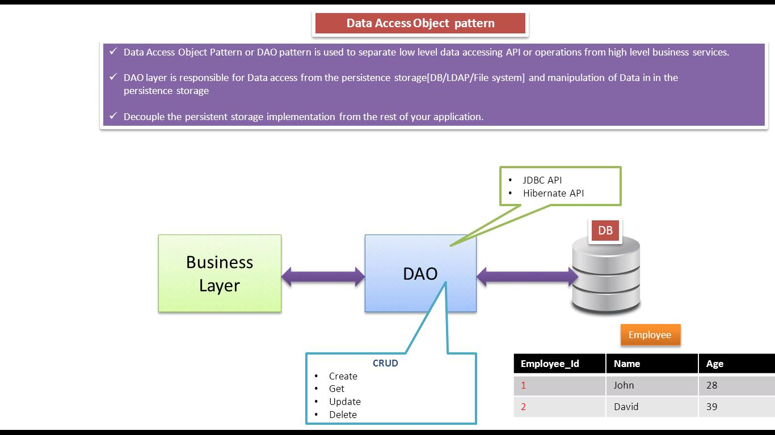
DAO pattern

Slide 3
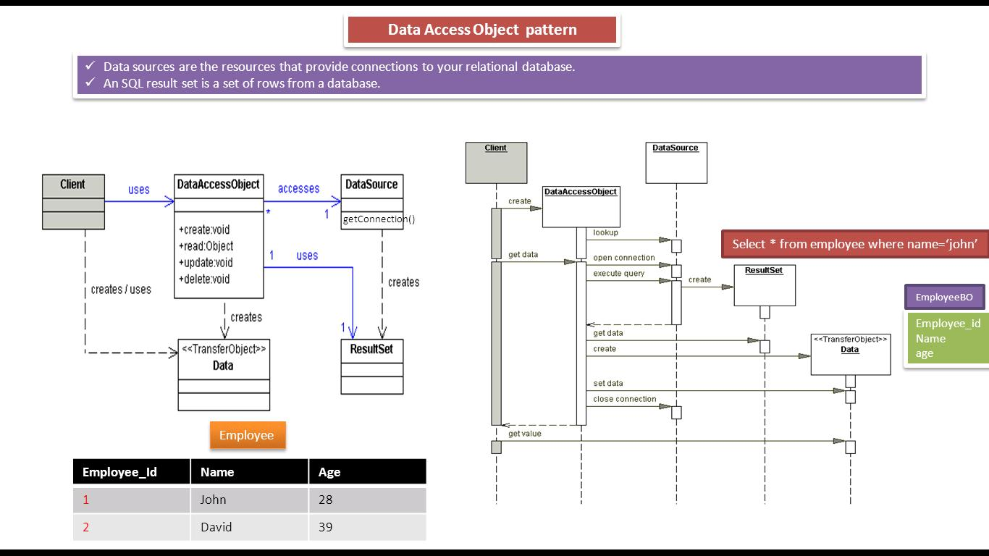
Class and Sequence diagram for DAO pattern

Slide 4
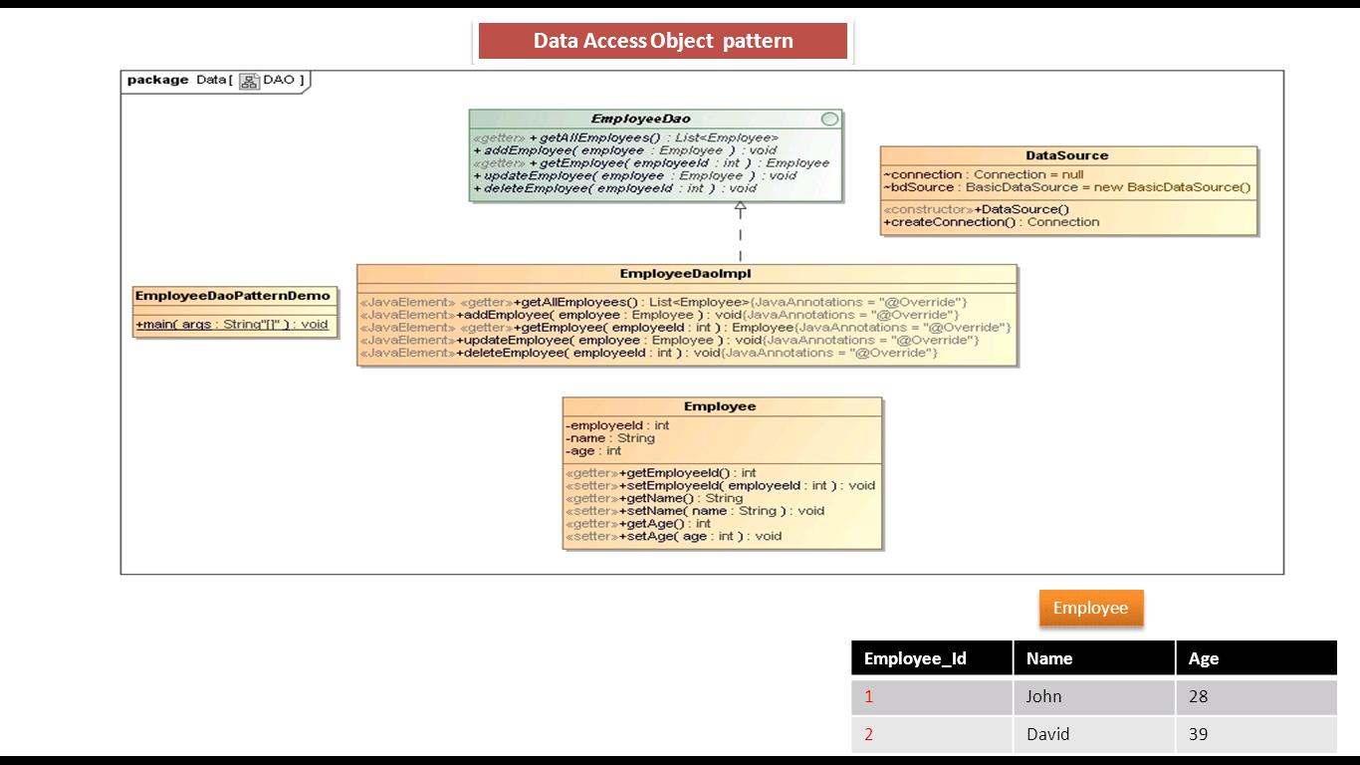
Implementation of DAO

Slide 5
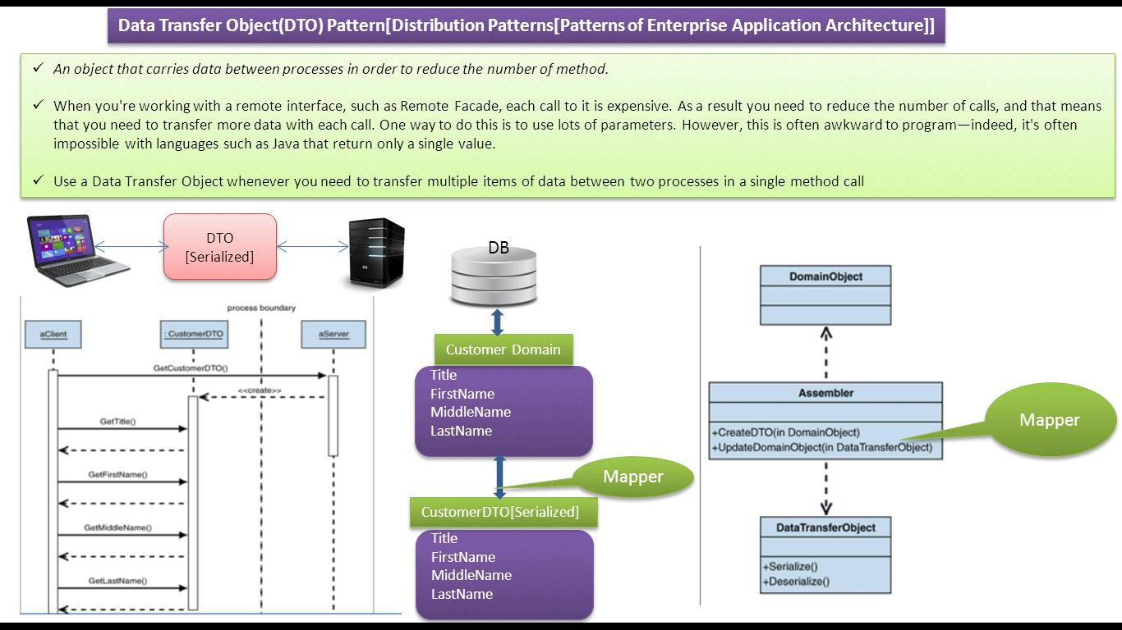
DTO Pattern

Slide 6
Thank You!

